Slide 1
Pharmacy project
MADE BY : “ Omar habib “ , “ omar samy “ , “Zedan “ , “ basyuni“

Slide 2
Project identification
Project about : Pharmacy store
Current problem : The system in the pharmacy was in papers so a lot of data is lost
Description about the project : it’s a very unique pharmacy app
It has all the medicine that you need , all the cosmetics and hygiene stuff , it exchanges the manual usage to all up to date technology

Slide 3
Planning phase
System Request | Feasibility Study | Project Plan

Slide 4
System Request

Slide 5


System Request – Pharmacy project
Medicinala company Marketing Manager CEO | Project sponsor:
Increase sales Improve social media ratings Improve customer services Decrease the lost data | Business need:
Provide online access Provide cloud storage Capture customers information | Business requirements:
10% Increase in sales $200,000 cost saved Increase the stock by 40% Decrease the number of employes by 30% | Business value:
Deadline in 22/12/2025 Top level security Network | Special issues:

Slide 6
Feasibility Study
.A feasibility study is like a reality check for a project idea. It helps answer questions like: Can we afford it? Is it technically possible? And is it okay with the rules? It's like giving the project a green light or a red light.
Example:
Technical Feasibility
Economic
Feasibility
Organizational
Feasibility

Slide 7
Technical feasibility :
-Familiarity with application
-Familiarity with technology
-Online live support
Economic feasibility:
Development costs of system will be 250k $
Annual operating costs 50k $
Annual profit 5%
Organizational
Feasibility:
Senior manager have full access to the system
Other employees will have less access
- Online tutorial for clients
USERS
Schedule
Feasibility:
- We will finish first release 12/9/2024

Slide 8
Project Plan
Methodology | Task Identification | Time Estimation
Methodology
In this level I use waterfall in my project because It's easy no To arrange information and stages

Slide 9
Tasks Identification
Example | Task Information
economic feasibility | Name of Task
1-12-2023 | Start Date
2-12-2023 | End Date
Habib | Person assigned to the task
High | Priority
Microsoft Word | Resources Needed
10 Hours | Estimated Time
8 Hours | Actual Time
Example | Task Information
Schedule feasibility | Name of Task
2-12-2023 | Start Date
4-12-2023 | End Date
Omar Mousa | Person assigned to the task
Low | Priority
Microsoft Word | Resources Needed
13 Hours | Estimated Time
15 Hours | Actual Time

Slide 10
Example | Task Information
Pert Chart | Name of Task
7-12-2023 | Start Date
12-12-2023 | End Date
Basyuni | Person assigned to the task
Medium | Priority
Power Point | Resources Needed
6 Hours | Estimated Time
3 Hours | Actual Time
Example | Task Information
Gant Chart | Name of Task
10-12-2023 | Start Date
12-12-2023 | End Date
Zedan | Person assigned to the task
High | Priority
Power Point | Resources Needed
14 Hours | Estimated Time
8 Hours | Actual Time

Slide 11
Task identification

Slide 12
Status | Dependency | Actual |  |  |  |  | Estimated |  |  | Responsibility | Task name | Task ID
None |  | end | start |  | duration |  | End | Start | Duration | None
open |  |  |  |  |  |  | 12/11/2023 | 10/11/2023 | 2 | Eng.Mosa | System Request | 1
open |  |  |  |  |  |  | 6/12/2023 | 1/12/2023 | 6 | Eng.Habib | Feasibility Analysis | 1.1.1
open |  |  |  |  |  |  | 1/12/2023 | 29/11/2023 | 2 | Eng.Basuni | Methodology | 1.2
open | 1.1.1 1.2.1 |  |  |  |  |  | 4/11/2023 | 1/11/2023 | 3 | Eng.Zidan | Time Estimation | 1.2.1
open |  |  |  |  |  |  | 20/11/2023 | 18/11/2023 | 2 | Eng.Habib | Task identification | 1.2.2
open | 1.2.1 |  |  |  |  |  | 12/12/2023 | 7/12/2023 | 3 | Eng.Basuni | Pert chart | 1.3
open | 1.1.1 |  |  |  |  |  | 12/12/2023 | 10/12/2023 | 2 | Eng.Zidan | Gant chart | 1.3.1
open |  |  |  |  |  |  | 16/12/2023 | 12/12/2023 | 4 | Eng.Mosa | Scope management | 1.3.2

Slide 13
Time Estimation
Implementation | design | analysis | planning
30% | 35% | 20% | 15% | Standard Percentage
6 | 7 | 4 | 3 | Estimate time Based on planning time

Slide 14
Pert Chart
Dutation | Predecessors | Description | Activity
2 | - | System Request | A
4 | - | Feasibility Study | B
2 | B | Methodology | C
3 | A,B | Time Estimation | D
2 | C | Task Identification | E
5 | C | Pert Chart | F
2 | D,E,F | Gant chart | G

Slide 15
Dutation | Predecessors | Description | Activity
2 | - | System Request | A
4 | - | Feasibility Study | B
2 | B | Methodology | C
3 | A,B | Time Estimation | D
2 | C | Task Identification | E
5 | C | Pert Chart | F
2 | D,E,F | Gant chart | G
Pert Chart
A
1
3
D
4
G
E
B
7
F
6
2
C
5

Slide 16
Gantt chart
Critical Path
B→ C→ F → G
Dutation | Predecessors | Description | Activity
2 | - | System Request | A
4 | - | Feasibility Study | B
2 | B | Methodology | C
3 | A,B | Time Estimation | D
2 | C | Task Identification | E
5 | C | Pert Chart | F
2 | D,E,F | Gant chart | G
Minimum Duration Time = 13
Time (days)

Slide 17
Systems Development Life Cycle (SDLC)
planning
Analysis
design
Development

Slide 18
Scope
Management
Ali
BESO
Ahmed
HABIB
Zidan
Hamed
Mohamed
Mosa
Salem

Slide 19
Interview
Question: Can you explain the purpose of the pharmacy application?
Answer: The pharmacy application aims to streamline the process of managing medications, prescriptions, and customer information for both pharmacists and customers. It should improve the overall efficiency and accuracy of pharmacy operations.
2.Question: What are the key features of the pharmacy application? Answer: Some key features of the pharmacy application include:
Prescription management
Medication inventory management
Customer profiles and prescription history
Online prescription refills
Drug interaction checking
Integration with healthcare providers for electronic prescriptions

Slide 20
3.Question: How will the pharmacy application benefit pharmacists?
Answer: The pharmacy application will benefit pharmacists by:
Providing quick access to patient information and prescription history
Automating prescription refills and reminders
Streamlining inventory management
Improving communication with healthcare providers
4.Question: How will the pharmacy application benefit customers?
Answer: The pharmacy application will benefit customers by:
Allowing them to manage their prescriptions online
Providing information about medications and potential drug interactions
Offering convenient ways to refill prescriptions
Improving communication with pharmacists for any medication-related queries

Slide 21
5.Question: How will the pharmacy application ensure data security and privacy?
Answer: The pharmacy application will implement various security measures such as encryption for data transmission, secure user authentication, and access control mechanisms to protect sensitive information. Compliance with regulations like HIPAA will also be ensured.
6.Question: How will the pharmacy application handle prescription refills?
Answer: The pharmacy application will allow customers to request prescription refills online, which will be processed by pharmacists after verifying the prescription information. Customers will be notified once the refill is ready for pickup or delivery.
7.Question: Can you describe the technology stack that will be used for developing the pharmacy application? Answer: The pharmacy application will be developed using technologies such as:
Frontend: React.js for the customer-facing interface
Backend: Node.js for the server-side logic
Database: MongoDB for storing prescription and inventory data
APIs: Integration with healthcare providers using HL7 or FHIR standards

Slide 22
Interview Report
Person Interviewed: Dr.Ali Interviewer: Project leader Purpose of interview: 1-To understand the goals and functionality of the pharmacy application. 2- To explore the benefits of the application for pharmacists and customers. 3-To discuss the technology stack and security measures for developing the application. Summary of interview: . Purpose and Features: The pharmacy application aims to streamline medication management for pharmacists and customers. Key features include prescription management, inventory tracking, customer profiles, online refills, drug interaction checking, and integration with healthcare providers. . Benefits: For pharmacists, the application offers quick access to patient information, automation of prescription refills, streamlined inventory management, and improved communication with healthcare providers. For customers, it provides online prescription management, medication information, convenient refills, and better communication with pharmacists. . Technology Stack and Security : the application has a high level security so It reduce data lost.

Slide 23
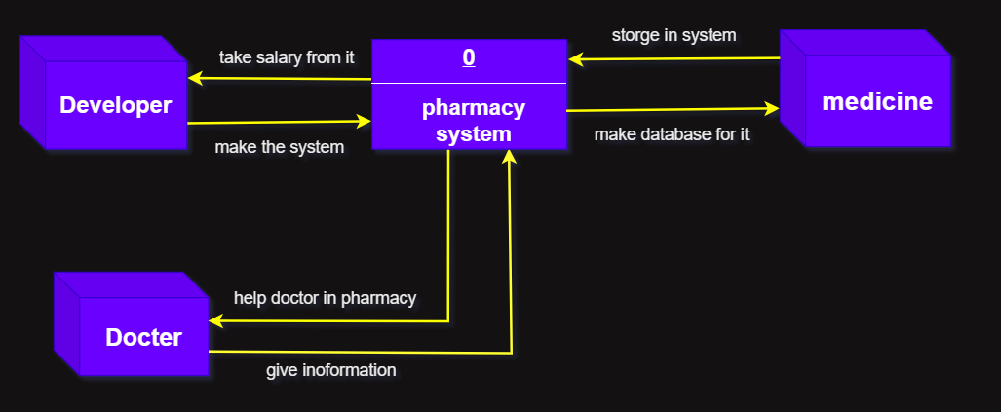
Context
Diagram

Slide 24
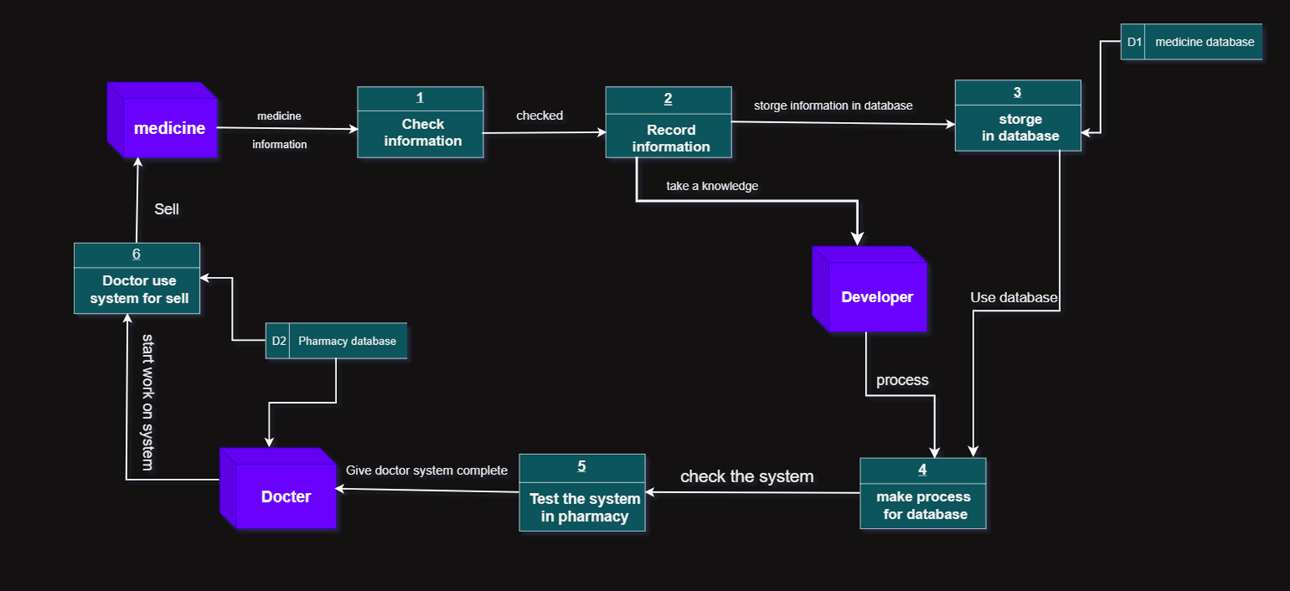
DFD LEVEL 0

Slide 25
DFD LEVEL 1

Slide 26
Data Dictionary – Data Flow
Data Flow Description Form ID: 1 Name : medicine information Description : This data flow represents the information related to the medicine, including their personal details, medical history, and current condition
Source medicine | Destination storge in database
Type of Data Flow File Screen Report Form Internal
Data structure medicine database | Volume/time 2/Days
Comments : This data flow is critical for maintaining accurate and up-to-date medicine record throughout the pharmacy management system.

Slide 27
Data Dictionary – Data Flow
Data Flow Description Form ID: 2 Name : Pharmacy database Description : This data flow represents the information related to the Doctor, including their personal details, medical history, and current condition
Source Doctor | Destination Doctor use System for sell
Type of Data Flow File Screen Report Form Internal
Data structure pharmacy database | Volume/time 1/Days

Slide 28
Data Dictionary – Data Flow
Data Flow Description Form ID: 3 Name : Medication Inventory Description : Orders from healthcare providers for specific medications to be administered to patients.
Source Pharmacy Database | Destination Medication delivery
Type of Data Flow File Screen Report Form Internal
Data structure Pharmacy Database |  | Volume/time 400/Month
Comments. This data dictionary provides a description and attributes for each component of the Medication Inventory data flow, outlining the information associated with prescription orders, requisitions, monitoring, ordering, management, dispensing, waste management, and inventory records

Slide 29
Data Dictionary – Data Flow Element Data:
Docter name | Name
Docter name | Alias
The owner of pharmacy | Description
120 | Length
X(120) | Input Format
X(60) | Output Format
- | Default Value
continuous | Continuous / Discrete
String | Type
Base | Base / Derived
- | Upper Limit
- | Lower Limit
- | Discrete
- | Comments

Slide 30
Data Dictionary – Data Flow Element Data:
Developer name | Name
Developer name | Alias
Creator of pharmacy system | Description
60 | Length
X(60) | Input Format
X(80) | Output Format
- | Default Value
Discrete | Continuous / Discrete
String | Type
Derived | Base / Derived
- | Upper Limit
- | Lower Limit
- | Discrete
- | Comments

Slide 31
Data Dictionary – Data Flow Element Data:
medicine name | Name
medicine name | Alias
The thing is selling in pharmacy | Description
20 | Length
X(20) | Input Format
X(100) | Output Format
- | Default Value
Continuous | Continuous / Discrete
String | Type
Base | Base / Derived
- | Upper Limit
- | Lower Limit
- | Discrete
- | Comments

Slide 32
Data Dictionary – Data Store
D1 | ID
Medicine information | Name
information file | Alias
Contains information about each medicine in pharmacy | Description
Computer | File Type
Database | File Format
10000 characters | Record Size
100000 | Maximum Records
80000 | Average Records
30% | Growth per Year
Medicine | Data Set
Medicine Data | Data Structure
Medicine ID | Primary Key
Medicine Name | Secondary Key
The file is update as the medicine information | Comments

Slide 33
Data Dictionary – Data Store
D1 | ID
pharmacy database | Name
Pharmacy file | Alias
Contains information about All medicine in pharmacy | Description
PC | File Type
Database | File Format
800000 characters | Record Size
1000000 | Maximum Records
80000 | Average Records
65% | Growth per Year
Pharmacy | Data Set
Pharmacy Data | Data Structure
Pharmacy ID | Primary Key
Pharmacy Name | Secondary Key
The file is update as the Pharmacy information | Comments

Slide 34
Process Specification
Process Specification Number: 1 Name: Collect Medicine information Description: collect data and information from Medicine to storge it
Input Data Flow Medicine Information
Output Data Flow medicine Records to process 2
Type of Process Online Batch Manual
Process Logic:
Structured English Decision Table Decision Tree

Slide 35
Process Logic – Structured English
Start of process
1- start collect data from each medicine like :
Quantity
Expiration data
The price
Discount percentage
End of process

Slide 36
Process Specification
Process Specification Number: 2 Name: storge information in Database Description: storge information and data in Database of system
Input Data Flow Existing Documentation
Output Data Flow Storge Records to process 3
Type of Process Online Batch Manual
Process Logic:
Structured English Decision Table Decision Tree

Slide 37
Process Logic – Structured English
Start of process
1-entry data in system
2- save the data
3-storge in database
End of process

Slide 38
Process Specification
Process Specification Number: 3 Name: Make process for Database Description: process the database to be ready to use In pharmacy
Input Data Flow check Database
Output Data Flow Resource Records to process 3
Type of Process Online Batch Manual
Process Logic:
Structured English Decision Table Decision Tree

Slide 39
Process Logic – Structured English
Start of process
1-start process all data in database
2-give the okay for database
End of process

Slide 40
Process Specification
Process Specification Number: 4 Name: selling until inventory end Description: Docter sell the medicine until the developer end the system
Input Data Flow Basic in pharmacy
Output Data Flow data flow Records to process 5
Type of Process Online Batch Manual
Process Logic:
Structured English Decision Table Decision Tree

Slide 41
Process Logic – Structured English
Start of process
1- until the developer end system
2- Docter sell the medicine it set barcode in it
End of process

Slide 42
Process Specification
Process Specification Number: 5 Name: Setting a barcode in medicine Description: put a barcode by Assistant of developer
Input Data Flow Assistant Information
Output Data Flow Records to process 6
Type of Process Online Batch Manual
Process Logic:
Structured English Decision Table Decision Tree

Slide 43
Process Logic – Structured English
Start of process
1-Assistant count the Quantity of each medicine
2- Developer print barcode on this count
3- Assistant setting a barcode
End of process

Slide 44
Process Specification
Process Specification Number: 6 Name: test the barcode Description: developer check if barcode is work in system
Input Data Flow check barcode
Output Data Flow Records to process 7
Type of Process Online Batch Manual
Process Logic:
Structured English Decision Table Decision Tree

Slide 45
Process Logic – Structured English
Start of process
1- Developer check the barcode and each of
Quantity of medicine
Expiration data
The price
discount
End of process

Slide 46
Process Specification
Process Specification Number: 7 Name: Docter start use system for selling Description: Developer end here task and Docter start use the system to sell the medicine
Input Data Flow Use it Records
Output Data Flow Give him… to data flow in pharmacy
Type of Process Online Batch Manual
Process Logic:
Structured English Decision Table Decision Tree

Slide 47
Process Logic – Structured English
Start of process
1- The end of Developer job
2 – the Docter take the pharmacy
And it ready
End of process

Slide 48
YearsofExperience
ERD Diagram
Expertise area
developer
Name
Developer_ID
Qualifications
medicine
doctor
ContactNo
Medicine _ID
Doctor_ID
Side effect
Name
Specialty
Name
Dosage

Slide 49
Normalization
DoctorID | Name | Speciality | Qualifications | ContactNo
D001 | Dr. Smith | Cardiology | MD, FACC | 123-456-7890
D001 | Dr. Smith | Cardiology | MD, FACC | 123-456-7890
D002 | Dr. Johnson | Pediatrics | MD, FAAP | 987-654-3210
D003 | Dr. Lee | Dermatology | MD, FAAD | 555-123-4567
D003 | Dr. Lee | Dermatology | MD, FAAD | 555-123-4567
D004 | Dr. Brown | Orthopedics | MD, FACS | 888-987-6543
D005 | Dr. Clark | Neurology | MD, FAAN | 111-222-3333
D006 | Dr. White | Ophthalmology | MD, FACS | 444-555-6666
D007 | Dr. Adams | Psychiatry | MD, DABPN | 777-888-9999
D008 | Dr. Hall | Gastroenterology | MD, FACG | 333-444-5555

Slide 50
Normalization (1NF)
DoctorID | Name | Speciality | Qualifications | ContactNo
D001 | Dr. Smith | Cardiology | MD, FACC | 123-456-7890
D002 | Dr. Johnson | Pediatrics | MD, FAAP | 987-654-3210
D003 | Dr. Lee | Dermatology | MD, FAAD | 555-123-4567
D004 | Dr. Brown | Orthopedics | MD, FACS | 888-987-6543
D005 | Dr. Clark | Neurology | MD, FAAN | 111-222-3333
D006 | Dr. White | Ophthalmology | MD, FACS | 444-555-6666
D007 | Dr. Adams | Psychiatry | MD, DABPN | 777-888-9999
D008 | Dr. Hall | Gastroenterology | MD, FACG | 333-444-5555

Slide 51
Normalization (2NF)
DoctorID | Speciality | Qualifications
D001 | Cardiology | MD, FACC
D002 | Pediatrics | MD, FAAP
D003 | Dermatology | MD, FAAD
D004 | Orthopedics | MD, FACS
D005 | Neurology | MD, FAAN
D006 | Ophthalmology | MD, FACS
D007 | Psychiatry | MD, DABPN
D008 | Gastroenterology | MD, FACG
DoctorID | Name | ContactNo
D001 | Dr. Smith | 123-456-7890
D002 | Dr. Johnson | 987-654-3210
D003 | Dr. Lee | 555-123-4567
D004 | Dr. Brown | 888-987-6543
D005 | Dr. Clark | 111-222-3333
D006 | Dr. White | 444-555-6666
D007 | Dr. Adams | 777-888-9999
D008 | Dr. Hall | 333-444-5555

Slide 52
Normalization (3NF)
Table does not have any transitive dependencies, so it is already in 3NF

Slide 53
DONE ☺

